Slide 1
OUT OF CHAOS COMES ORDER
SEN CASE LAW UPDATE
FIONA SCOLDING/ALEX CAMPBELL
HARDWICKE BUILDING
18TH JUNE 2014

Slide 2
SEN CASE LAW
Two objectives:
Recent case law
Encourage debate around future challenges under the CFA 2014.

Slide 3
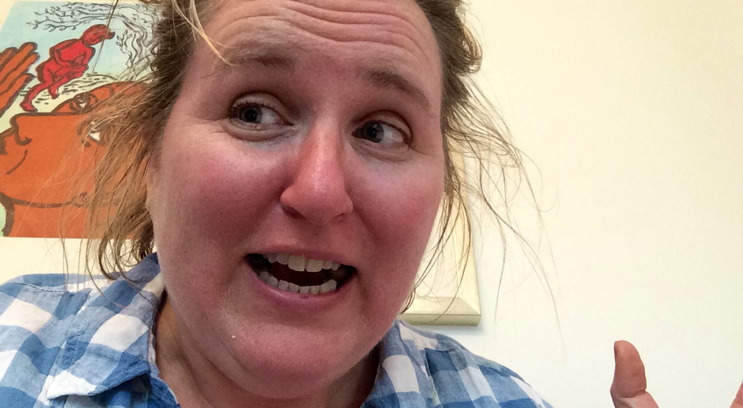
READING THE NEW CODE

Slide 4
SM V HACKNEY LEARNING TRUST
[2014] EWCA Civ 397
Does Schedule 27 paragraph 8 mean that the Authority has to consider s9?
Hackney refused a change of placement from a Hackney special school to an Islington special school – alleged inefficient use of resources as Islington would recoup £26k cost of the placement.
FTT determined that practical factors did not outweigh the additional costs

Slide 5
SM V HACKNEY (2)
Appeal to UT on the basis that s9 had not been looked at – if this had been, then no unreasonable public expenditure. The judge decided s9 was not engaged and the only exercise was that under para 8 of Schedule 27.
CA said he was wrong. Section 9 is engaged by reason of s324(4) of the Act under para 8 of Schedule 27 so that the there is a power to use s9 and to name it. The Court found that the desirability of ensuring that a school is appropriate for a child has as much during the life of the Statement as at its inception.

Slide 6
Practical Impact
New law replicates old law on granting the right of change
Means will have to identify public expenditure of both local authorities and whether or not savings of one with recoupment of another.

Slide 7
WH v Warrington
[2014] EWCA Civ 398
What is public expenditure under s9 of the EA 1996?
Section 9 is retained under the CFA 1996 – the EA 1996 is not repealed in this respect.
New extended definition of SEN in s21(5) to include health or social care provision which educated or train a child or young person.

Slide 8
WH v Warrington (2)
Facts: parents wanted residential special school: LA wanted day school plus respite care. Argument as to whether or not respite costs should be included when assessing the costs of the respective placements.
UT found that such costs were not public expenditure as that simply meant expenditure of the education budget.

Slide 9
WH v Warrington (3)
CA reversed this.
Public expenditure means spending by a public body, as opposed to a private body. If it were to limit scrutiny to simply the education budget, Parliament would have said so.
See contrast between Schedule 27 and s9 i.e. resources compared to public expenditure.
Could not therefore leave out respite care costs.

Slide 10
WH v Warrington (4)
Timely reminder that the resources to be taken account of under Schedule 27, para 3 are solely those of the LA in its education functions and no other (following B v Harrow)
But given that s9 exercise would follow anyway in the event that parental preference is refused under Sched 27, other costs may then become relevant.

Slide 11
Which costs?
Given new definition, will always be social and health care related to education.
Also respite care/other sorts of fostering/accommodation
Additional housing costs?
Nursing care provided by NHS if will be provided at the parental choice of placement.

Slide 12
Practical steps to take
CCG have duty to co-operate under s322 and have strengthened duties under new Act
Also part of Public Health Improvement Boards
Need to have figures from them if they charge the LA for education services
Social services budgets – need to know what is pre=funded and what is not.

Slide 13
CM v Surrey
2014 UKUT 4
When should the FTT permit an extension of time when a parent is late in bringing the appeal?
Mum appealed in person and about a month out of time . Tribunal refused to allow the appeal.
UT said FTT was wrong.

Slide 14
CM v Surrey (2)
FTT found that the right to permit a late appeal was unfettered:
Have to look at length and reasons for delay, chances of the appeal succeeding and the degree of prejudice to the other side
Also the impact of other users of the system
Must look at the merits of the appeal when considering whether to extend time .
No duty to hold a hearing, however, before reaching a decision of delay.

Slide 15
K v The Authority
UKUT 624
Meaning of “taught in small groups” within a Statement.
Taught in small groups meant that she should be taught in small classes within school, not in a small supported group within a normal class size.
Tribunal should make it clear what meant by taught in small groups within the Statement to ensure appropriate specificity.

Slide 16
SG v LB Bromley
[2013] UKUT 619
Tribunal had not erred in finding that his selective mutism was non educational in nature and could be dealt with within a specialist therapy centre not related to his education
However this was a s319/ s19 case (child was out of school) – the Tribunal had failed to grapple with whether or not he should be provided with a full time package out of school.

Slide 17
TB v Essex CC
[2013] UKUT 534
What is a school?
LA had named unit attached to an Academy which was a project for pupils with behavioural difficulties to have them reintegrated back into their mainstream school. The child would be , however, registered at a PRU

Slide 18
TB v Essex ( 2 )
Tribunal found that as he was registered with a PRU, they did not need to investigate whether or not the actual provision was a school
UT found that was wrong: child could only be educated other than at a school if school based provision was not appropriate under s319. The Tribunal had erred by not asking whether or not the project provision was or was not a school.
However Tribunal found that it looked very much like a school and had the usual indicia for it (curriculum, governance, regulation, financing, admin) and that it was not unlawful for the FTT to have named the PRU together with the project in Part 4 of the Statement.

Slide 19
BUCKS CC V HW
[2013] UKUT 470
What is necessary for the purposes of determining whether or not there should be a statutory assessment?
Necessary was somewhere between indispensible and useful or reasonable.
Whether something was necessary assumes a reason and a purpose which is to identify whether further educational provision was or would be required
Consideration of such issues had to look to the future, and not simply the current situation.

Slide 20
Bucks CC v HW (2)
Court gave general guidance on LA’s appealing
Identified that if wished to appeal, should do so quickly and seek a suspension of the FTT decision at the same time.
Without a suspension, the FTT decision must be implemented.

Slide 21
Bucks CC v ST
[2013] UKUT 470
Case compromised on the day of the hearing before hearing any argument to name parent’s school
Judge ordered costs on the basis that the LA should have conceded before .
Judge set aside this decision on the basis that the case had truly compromised, and that should not judge a compromise in the same way as a defeat – and that it should be cautious about giving provisional views to the parties in the absence of evidence.

Slide 22
THE FUTURE
Previous case law will still stand if the legislation is written in the same way – so meaning of special educational provision will alter slightly as the terminology has changed.
Section 21(5) which extends /alters the definition of special educational provision does so in line with current case law – it implements Bromley v SENT into statute: so if health and social care “educates or trains” then it is special educational provision
But note that definition of special educational needs has not changed.
Assume old law applies to the new Act unless the definitions/meanings have radically changed, which is not the case for most of the legislation – it is a tightening up , rather than a wholesale amendment of what is meant by planning for those with SEN.

Slide 23
The twin track appeal system
The old , i.e. 1996 Act system and the new CFA 2014 act system will run in parallel for up to 4 years.
New case law on the new Act will not impact upon the old law unless it deals with identical statutory language or an issue common to both systems .
Case law on the New Act and its interpretation will only be relevant to decisions under the old Act if they have identical statutory language – i.e. meaning of special educational needs .
However, there may be some new “thinking” by the FTT as to the approach to be taken, knowing that these children will have EHIC plan if they are under 19 now.

Slide 24
OBVIOUS AREAS OF CHALLENGE
Judicial Review if parent wants to use personal budget system in place under CFA 2014 but LA wishes to continue with Statement under 1996 Act
Transferring from Statements to EHIC – when should it happen.
Post 16 provision – using s139 Guidance until 2015 which is not terribly useful.
Post 16 provision in general – this is all new territory and will involve a lot of learning by all of us.

Slide 25
FURTHER AREAS OF CHALLENGE
Whether or not the Care Act 2014 will allow parents to appeal social care provision to the FTT?
The crossover between health, social care and education will still be a major battleground, especially for those over 18 where things get a lot more blurred in terms of what is education and training.

Slide 26
PERSONAL BUDGETS
Whole host of challenges:
How they are assessed and calculated:
Against what form of notional cost ?
What happens when an LA wants a notional budget and a parent wants an actual one?
Organising payments to third parties
Supervising direct payments/ensuring that parents give proper accountability.

Slide 27
MEDIATION
Given compulsory mediation under the new system ,
Organising and arranging mediation concerning health and social care provision alongside educational provision:
Having in place appropriately qualified mediators:
Organising a mediation certificate

Slide 28
FURTHER PROBLEMS
No standardisation of EHIC plans
How does this work on transfer
Wildly varying in quality – eg one I have seen says “How will [ ] feel?” – how do you quantify feelings?

Slide 29
POST 16
Will all plans be able to be amended some 7 months before transfer?
How will this process work?
Gaining co-operation with the FE sector
Training of the FE sector on Tribunal requirements.

